Slide 1
Constraining the source of significant variation in orographic drag representation in numerical weather prediction: a model orography intercomparison and implications for drag parameterization
Andy Elvidge¹, Irina Sandu², Nils Wedi², Ayrton Zadra³, Simon Vosper¹, Masashi Ujiie⁴, Mikhail Tolstykh⁵, Francois Bouyssel⁶, Anton Beljaars², Souhail Boussetta², Annelize Van Niekerk¹
¹ Met Office, ² ECMWF, ³ Canadian Meteorological Centre, ⁴ Japan Meteorological Agency, ⁵ Russian Academy of Sciences, ⁶ Météo France

Slide 2
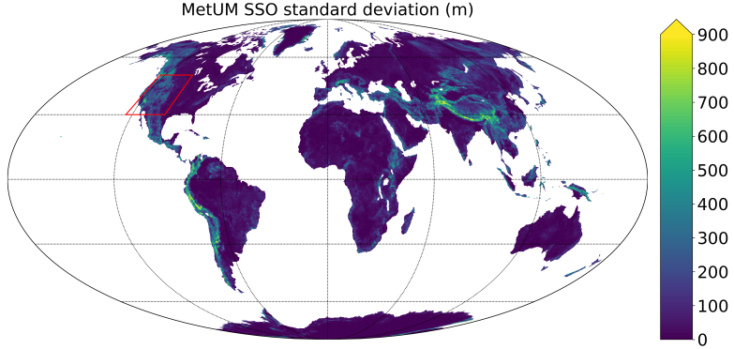
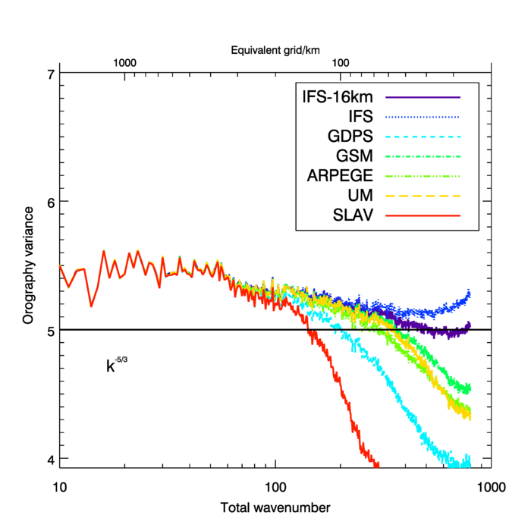
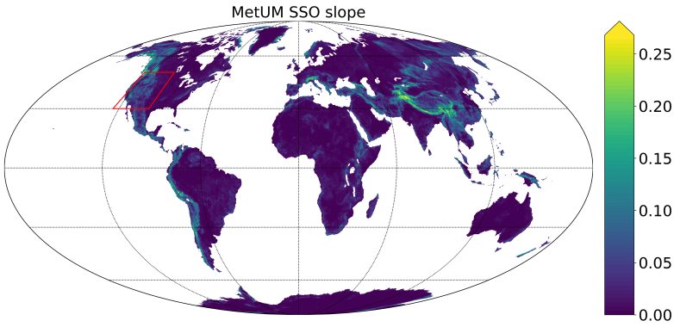
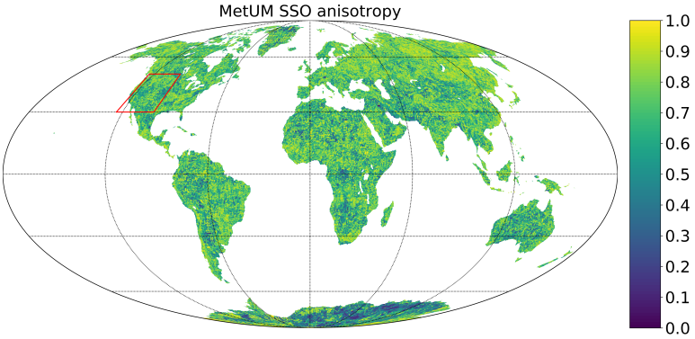
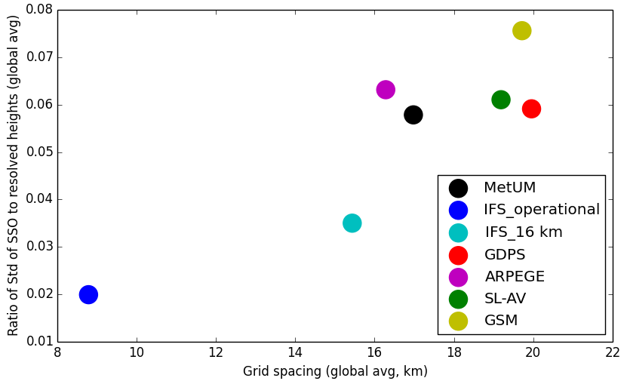
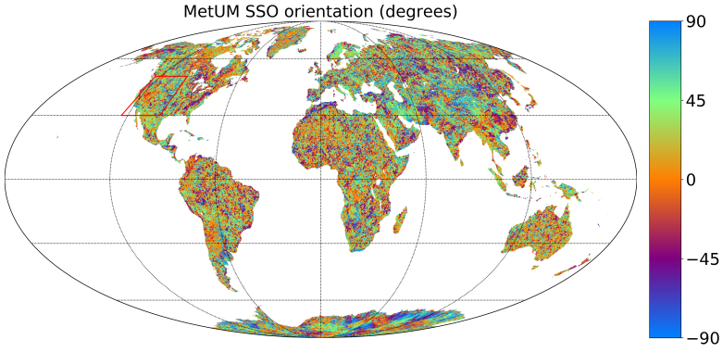
Power spectra of mean (resolved) grid box orography:
Height:
Height of subgrid-scale mountains, given by the grid-box standard deviation of subgrid-scale orography (SSO)
Slope:
Grid box SSO gradient
Anisotropy:
Ridge-like (0) to dome-like (1) SSO
Relatively higher sub-grid orography
GLOBE
2.7∆x
Subgrid/resolved orographic heights vs resolution, data source, strength of orographic filter
GTOPO30
3∆x
7.2∆x
Orientation:
SSO ridge angle
4∆x
4∆x
SRTM30
2.2∆x
2.2∆x
Relatively higher resolved orography
All SSO fields vary significantly across models

Slide 3
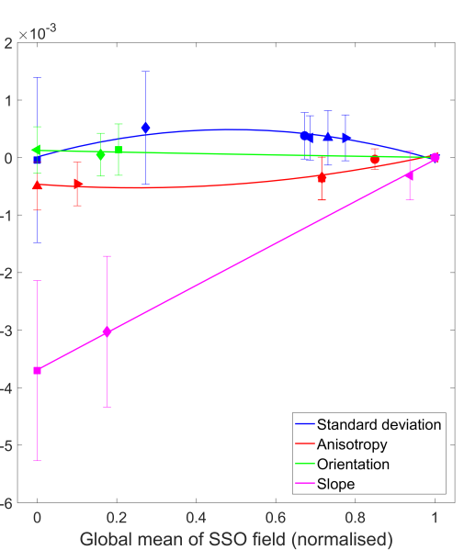
Offline SSO field sensitivity experiments (using Lott and Miller scheme) show:
Global-average stress most sensitive to inter-model variability in slope, but both slope and height influential locally
Local Froude number controls polarity and strength of drag response to variability in height
Influence of anisotropy and orientation fields relatively small
Effect on global surface stress

Slide 4
Offline SSO field sensitivity experiments (using Lott and Miller scheme) show:
Global-average stress most sensitive to inter-model variability in slope, but both slope and height influential locally
Local Froude number controls polarity and strength of drag response to variability in height
Influence of anisotropy and orientation fields relatively small
Effect on global surface stress
IFS experiments where SSO fields are substituted for MetUM SSO fields:
Combined effect of height & slope required to explain response in P_{sfc}
Positive polar pressure signature resembles known MetUM model bias
All fields Height&Slope Height Slope Orientation Anisotropy
substituted substituted substituted substituted substituted substituted

Slide 5
Offline SSO field sensitivity experiments (using Lott and Miller scheme) show:
Global-average stress most sensitive to inter-model variability in slope, but both slope and height influential locally
Local Froude number controls polarity and strength of drag response to variability in height
Influence of anisotropy and orientation fields relatively small
Effect on global surface stress
IFS experiments where SSO fields are substituted for MetUM SSO fields:
Combined effect of height & slope required to explain response in P_{sfc}
Positive polar pressure signature resembles known MetUM model bias
All fields Height&Slope Height Slope Orientation Anisotropy
substituted substituted substituted substituted substituted substituted
IFS
IFS with MetUM
SSO fields
Relative diff.
Dec, 2016
Jan, 2012
IFS
MetUM
Relative diff.
Inter-model variability in SSO fields can be of first-order importance to the variability in drag seen across models
Zadra (2013)

