Slide 1
PDEF – WG on
Predictability, Dynamics & Ensemble Forecasting
Co-chairs: Craig Bishop and John Methven
Japan Meteorological Agency, Tokyo, October 2018

Slide 2
Contents
Current membership of the PDEF WG
Remit of PDEF and its 5 challenge topics
Summary of key future activities

Slide 3
PDEF members and objectives
Co-chairs
Craig Bishop – University of Melbourne, Australia
John Methven – University of Reading, UK
Members
Munehiko Yamaguchi – JMA/MRI, Japan
Oscar Alves – CAWCR, Australia
Judith Berner – NCAR, USA
Zhiyong Meng – University of Peking, China
Mark Rodwell – ECMWF
Olivia Romppainen-Martius – University of Bern, Switzerland
Susanne Theis – DWD, Germany
Mio Matsueda – University of Tsukuba, Japan
TIGGE panel chair: Manuel Fuentes – ECMWF
Stemming from THORPEX, PDEF provides expertise in the key areas of predictability, dynamics and ensembles.

Slide 4
Five PDEF Challenge Topics
Construction of ensemble initial conditions (Craig Bishop, Mio Matsueda)
Stochastic representation of the effect unresolved processes in models and model error (Judith Berner, Mark Rodwell)
Coupled modelling & assimilation (Oscar Alves, Zhiyong Meng)
Role of diabatic processes in weather system dynamics (John Methven, Olivia Romppainen-Martius)
Spatio-temporal post-processing for ensemble applications (Munehiko Yamaguchi, Susanne Theis)

Slide 5
Challenge 1: Ensemble ICs
TIGGE, its continuity and utilisation is a responsibility of PDEF
Challenges for ICs from inherently non-Gaussian variables and nonlinear observation operators in assimilation (e.g., wind speed, humidity)
Utilisation of high resolution observations for ensemble spread and reliable forecast – assimilation of cloudy satellite radiances and radar
Planned activities
TIGGE/S2S ensembles workshop, ECMWF, 2-5 April 2019
(registration open until 30th November 2018)
Plan to obtain commitment to extend TIGGE to end of 2023
DA Symposium, Kobe, January 2019

Slide 6
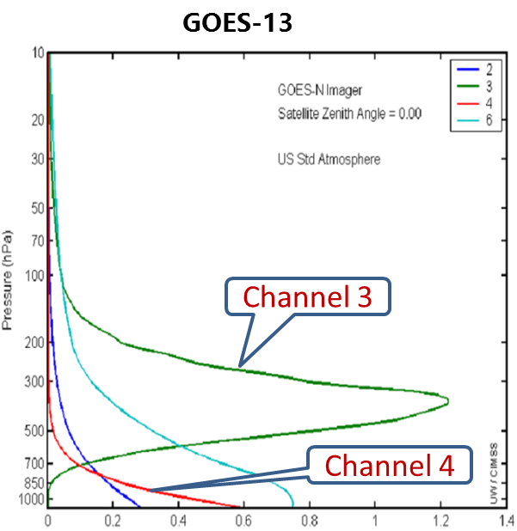
Assimilate Ch3 verify on Ch4 moisture radiance
OBS
Rad
NoRad
12Z29
24h
00Z30
36h
Improved lower-level TC structure

Slide 7
Challenge 2: Stochastic parametrization
Formulation of stochastic parametrization in NWP
Representation of uncertainty stemming from unresolved processes
Stochastic influence on transitions between patterns of variability, climate state and reducing model bias
Planned activities
Coarse-graining experiments
Using convection-permitting global (or LAM on large domains) simulations
Use tendencies within low resolution grid boxes to inform design of stochastic parametrization mimicing upscale effect of sub-grid processes on resolved scales
EGU 2019 session: Representing uncertain sub-grid processes in weather and climate models

Slide 8
Stochastic parametrization

Slide 9
Challenge 3: Coupled modelling and assimilation
How to create ensembles for coupled systems?
Coupled data assimilation as a means to define ensemble ICs
Addressing coupled model bias in ensemble design
Assimilating variables with a strong stochastic element (cloudy sky)
Planned activities
Assimilating all sky high resolution satellite data into ensemble forecasts
Ramifications for probabilistic rainfall prediction

Slide 10
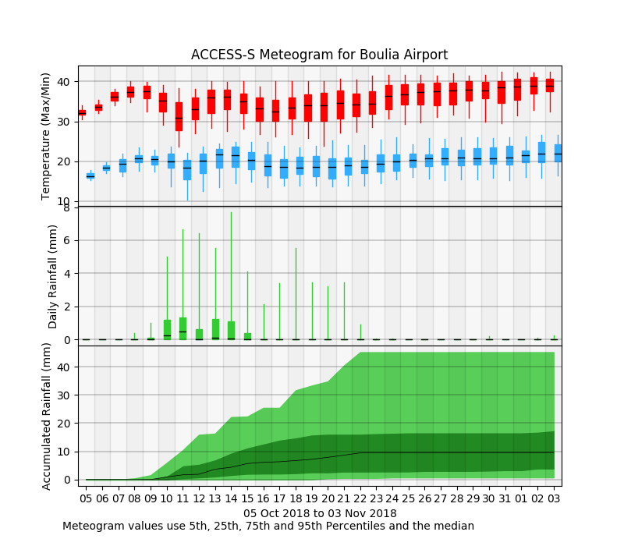
Key BoM Project – Forecasting extremes (multiweek/seasonal)
33 ensembles per day
Q-Q daily mapping calibration
Use 33 to 7 days
Increase to 99 by 15 days with 3 day lag
Issue for accumulated rainfall

Slide 11
Challenge 4: Diabatic processes in dynamics of weather systems
Major uncertainties in the representation of heating distributions arising from parametrized diabatic processes
Implicated in “forecast busts” (e.g., Rodwell et al, BAMS)
Campaigns observing physical processes in active weather systems
North Atlantic Waveguide and Downstream Impacts Experiment (NAWDEX) conducted successfully, Sept-Oct 2016.
Review of blocking – Woollings et al (2018), Clim. Change Rep.
Planned activities
NAWDEX-AMIP – running climate models in NWP mode and using NAWDEX obs to evaluate physical processes
Possible THINICE campaign summer 2020 Arctic cyclones & sea ice
SPARC/PDEF stormtracks workshop 2021

Slide 12
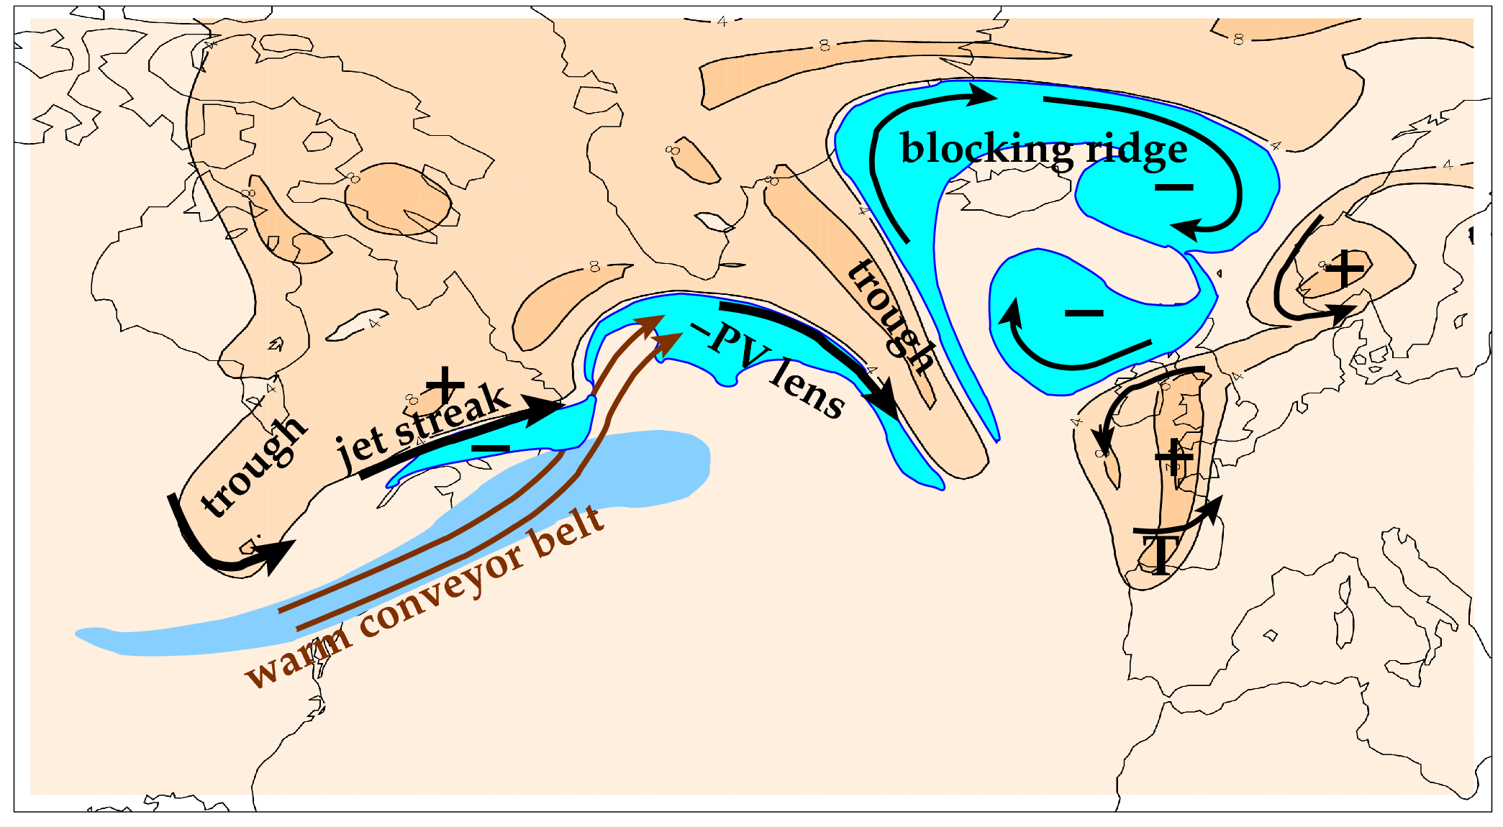
Overarching scientific aim of NAWDEX: to quantify the effects of diabatic processes on disturbances to the jet stream near North America, their influence on downstream propagation across the North Atlantic, and consequences for high-impact weather in Europe.
Features related to the meandering tropopause and jet stream (orange is stratospheric air; cyan marks upper tropospheric PV anomalies).

Slide 13
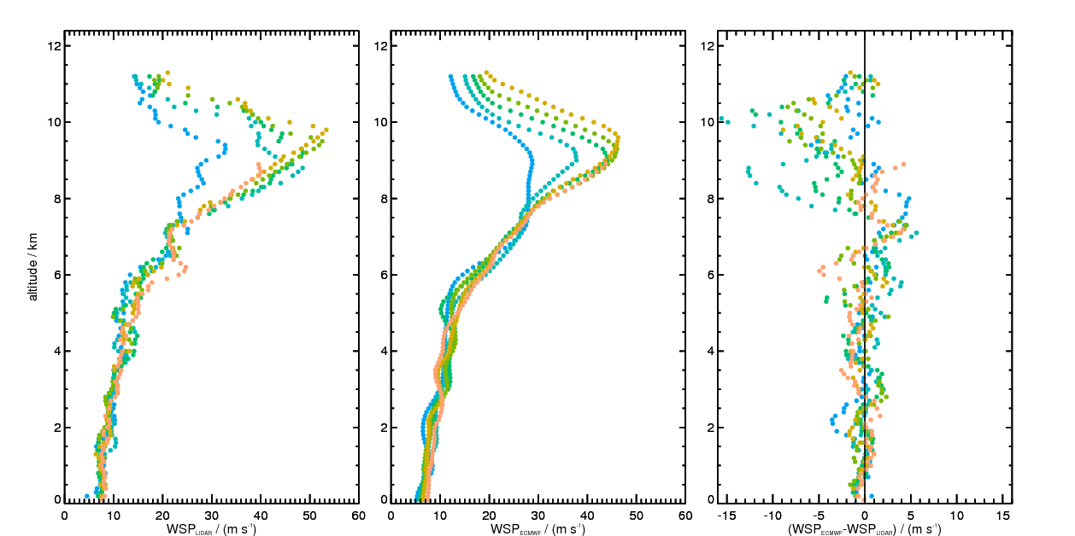
RF04: 23/9/16 (DLR wind lidar)
analysis - obs wind speed
Systematic error identified
dropsondes
ECMWF
difference
z

Slide 14
Challenge 5: Spatio-temporal post-processing for ensemble applications
Recalibration of ensembles is typically needed before use in applications for reliable forecasts
BUT, current techniques based on single sites, single variable
To preserve plausible “trajectories” of system, or scenarios, recalibration needs to preserve relationships between variables, as well as spatial and temporal coherence
Planned activities
Post-processing challenges based on imperfect functions representing typical transformations from predicted variables to application-relevant metrics. E.g., concept of a “hypothetical user”.
Added value of high resolution ensembles for HIW and impacts

Slide 15
“Multivariate” Postprocessing
reconstructs / preserves scenarios
dependencies of „forecast errors“
- in space / time (patterns, evolution)
- between variables
relevant if impact involves:
- aggregations, derivatives, combinations, …
(see references in blue box)
if omitted, risk of misinterpretation:
- aggregation of quantiles, etc
Example 1
Example 2
Bessa et al. (2017): „Towards improved Understanding of the Applicability of Uncertainty Forecasts in the Electric Power Industry“, Energies.
„What is important when forming a probabilistic forecast of severe and/or high impact weather for an end user?“, Isla Finney,
Figures adapted from: Bouallègue etal (2016)

Slide 16
Ways to engage with PDEF activities
High resolution simulations and contribution to coarse-graining experiments (design of stochastic parametrization)
S2S stochastic versus non-stochastic forecast comparison
NAWDEX-AMIP: simulations of NAWDEX period for model comparison in period of unprecedented data coverage
Possible Arctic cyclone field experiment in summer 2020
Use TIGGE and S2S ensemble forecast databases in research (and operations)
Register for TIGGE-S2S workshop at ECMWF

Slide 17
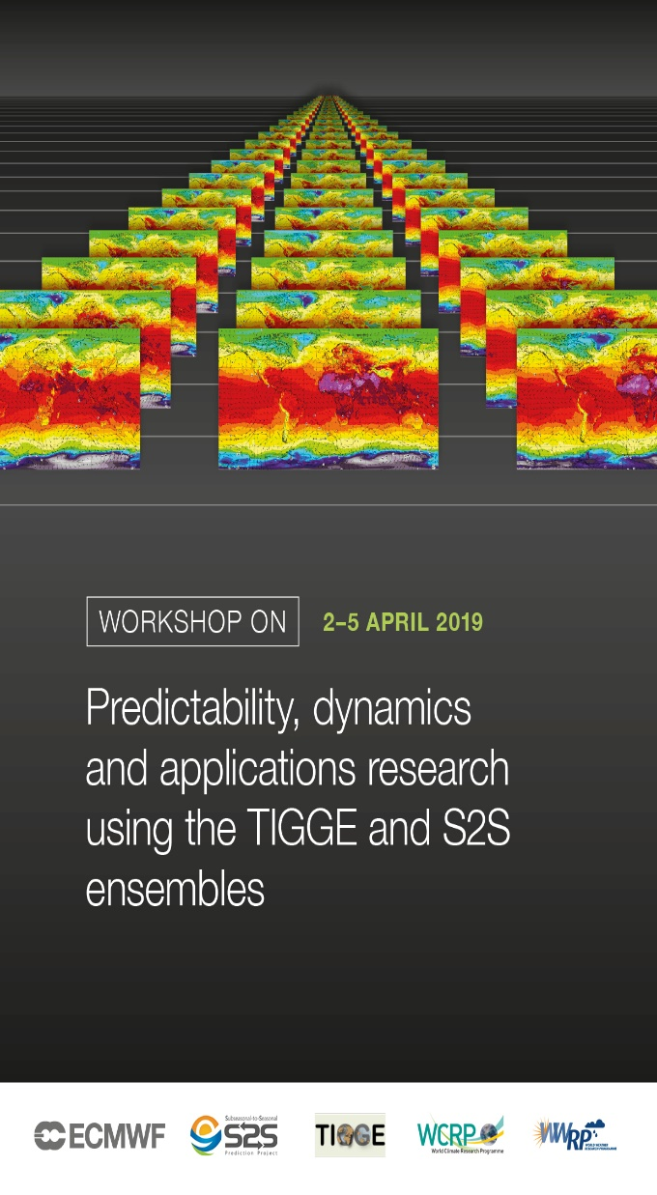
TIGGE-S2S Workshop – April 2019
Workshop on Predictability, dynamics and applications
research using the TIGGE and S2S ensembles
ECMWF, Reading, 2-5 April 2019
To bring together the users and data providers of the
TIGGE and S2S databases around the following themes:
Database technical development
Predictability and Dynamics
Prediction and Verification
Multi-Model approaches to prediction
Application Studies
Registration and abstract submission close on 30 Nov.
https://www.ecmwf.int/en/learning/workshops/workshop-predictability-dynamics-and-applications-research-using-tigge-and-s2s-ensembles

Slide 18
Thank you for your attention

